Slide 1



Playing well with others increasing compatibility between commons licences
Jessica Coates
Project Manager
Creative Commons Clinic
AUSTRALIA
part of the Creative Commons international initiative
CRICOS No. 00213J

Slide 2


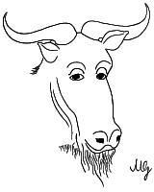
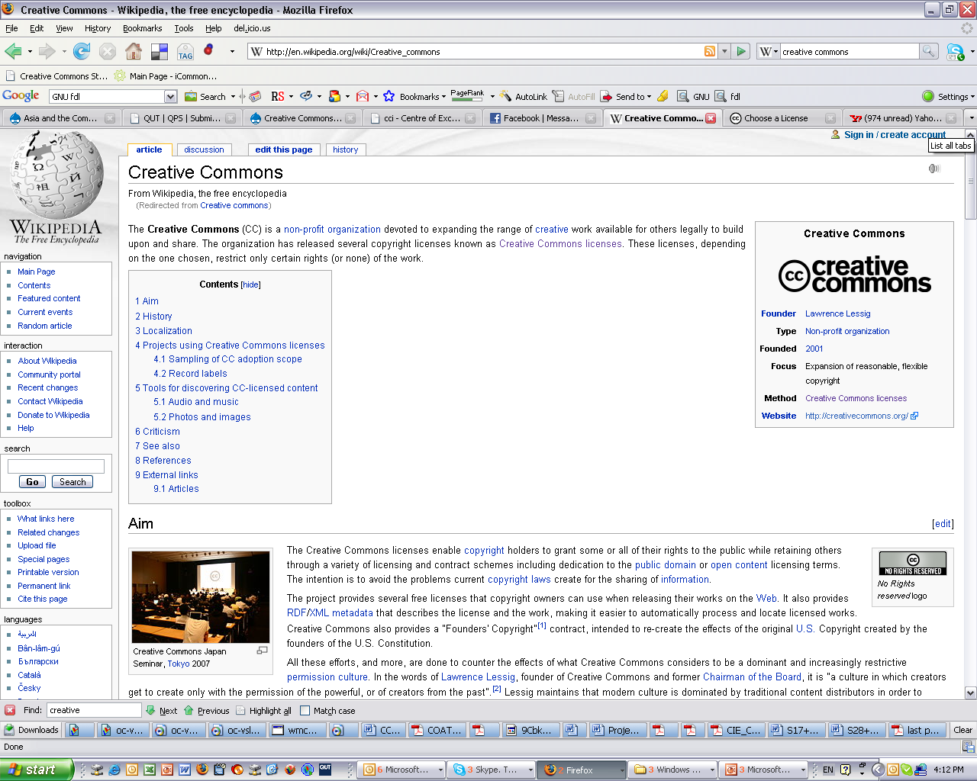




What is compatibility?
AUSTRALIA
part of the Creative Commons international initiative
CRICOS No. 00213J
Notes:
The first CC licences were released in 2002
The central to each of the CC licences are the four licence elements – Attribution, noncommercial, no derivative and sharealike
These represent restrictions that copyright owners may want to put on how people can use their material.
As you can see, each of the elements has a symbol that can be used to ‘represent’ each of these elements
this makes the licences easier understand – in theory, once a person is familiar with the CC licences, they should be able to recognise what uses are allowed simply by looking at the symbols

Slide 3
What is compatibility?
Occurs in copyleft/sharealike licences ie that require you to re-license only under original licence
fundamental aspect of many open licences – part of FSF’s Free Software Definition - very popular
Intentional incompatibility – cannot re-license material under any other licence (copyleft or not)
Unintentional incompatibility - material published under two different copyleft licences cannot be combined into one work – because both require you to re-license only under the same licence
AUSTRALIA
part of the Creative Commons international initiative
CRICOS No. 00213J
Notes:
The first CC licences were released in 2002
The central to each of the CC licences are the four licence elements – Attribution, noncommercial, no derivative and sharealike
These represent restrictions that copyright owners may want to put on how people can use their material.
As you can see, each of the elements has a symbol that can be used to ‘represent’ each of these elements
this makes the licences easier understand – in theory, once a person is familiar with the CC licences, they should be able to recognise what uses are allowed simply by looking at the symbols

Slide 4
Why is it important?
One of most common criticisms made of the open licensing movement
Causes ‘ghetto-isation’ of material – once you place a copyleft licence on material, you are restricting it to only being used with certain other material
Also one of biggest practical barriers to creation of a true ‘commons’ – ie a pool of material that can be shared and remixed freely
Relates to other criticisms of the commons eg licence proliferation
AUSTRALIA
part of the Creative Commons international initiative
CRICOS No. 00213J
Notes:
The first CC licences were released in 2002
The central to each of the CC licences are the four licence elements – Attribution, noncommercial, no derivative and sharealike
These represent restrictions that copyright owners may want to put on how people can use their material.
As you can see, each of the elements has a symbol that can be used to ‘represent’ each of these elements
this makes the licences easier understand – in theory, once a person is familiar with the CC licences, they should be able to recognise what uses are allowed simply by looking at the symbols

Slide 5
Possible solutions
Make material compatible by:
    Not using copyleft clauses – not going to happen
    Dual licensing – used by many wikis
        Can only be done by copyright owner
        Only allows compatibility with chosen licences
        Can be confusing and complex
Make licences compatible
    Explicit licence text permitting cross-licensing – approach taken in CC BY-SA v3.0, GNU FDL v2.5
AUSTRALIA
part of the Creative Commons international initiative
CRICOS No. 00213J
Notes:
The first CC licences were released in 2002
The central to each of the CC licences are the four licence elements – Attribution, noncommercial, no derivative and sharealike
These represent restrictions that copyright owners may want to put on how people can use their material.
As you can see, each of the elements has a symbol that can be used to ‘represent’ each of these elements
this makes the licences easier understand – in theory, once a person is familiar with the CC licences, they should be able to recognise what uses are allowed simply by looking at the symbols

Slide 6
Recent developments
Recent moves to make CC BY-SA licence compatible with GNU FDL
Very significant - two of most commonly used open content licences
Spearheaded by Jimmy Wales of Wikipedia – with a view to migrating Wikipedia to CC BY-SA
Would mean that CC BY-SA licensed material (eg Flickr photos) could be used on Wikipedia, or mixed with Wikipedia material to create derivative works
AUSTRALIA
part of the Creative Commons international initiative
CRICOS No. 00213J
Notes:
The first CC licences were released in 2002
The central to each of the CC licences are the four licence elements – Attribution, noncommercial, no derivative and sharealike
These represent restrictions that copyright owners may want to put on how people can use their material.
As you can see, each of the elements has a symbol that can be used to ‘represent’ each of these elements
this makes the licences easier understand – in theory, once a person is familiar with the CC licences, they should be able to recognise what uses are allowed simply by looking at the symbols

Slide 7

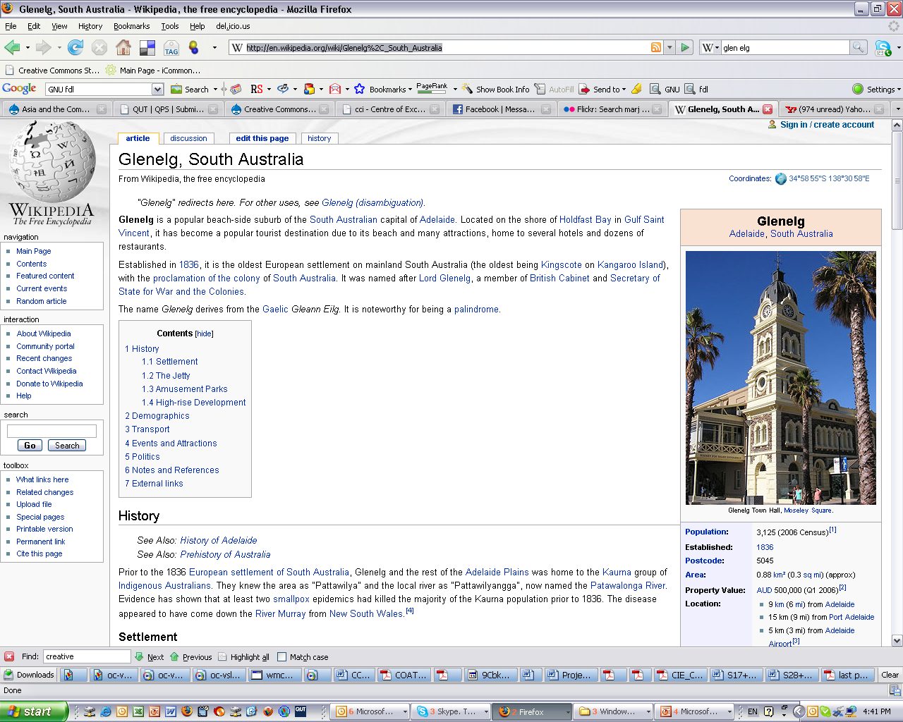
Recent developments
AUSTRALIA
part of the Creative Commons international initiative
CRICOS No. 00213J
Notes:
The first CC licences were released in 2002
The central to each of the CC licences are the four licence elements – Attribution, noncommercial, no derivative and sharealike
These represent restrictions that copyright owners may want to put on how people can use their material.
As you can see, each of the elements has a symbol that can be used to ‘represent’ each of these elements
this makes the licences easier understand – in theory, once a person is familiar with the CC licences, they should be able to recognise what uses are allowed simply by looking at the symbols

Slide 8
Process so far
CC BY-SA v3.0 – introduced compatibility language – allows BY-SA material to be re-licensed under ‘a Creative Commons Compatible License’
FSF proposes changes to GNU FDL to allow migration – allows GNU FDL to be re-licensed under proposed GNU Wiki licence
Wikipedia Foundation Board votes to support GNU FDL changes
AUSTRALIA
part of the Creative Commons international initiative
CRICOS No. 00213J
Notes:
The first CC licences were released in 2002
The central to each of the CC licences are the four licence elements – Attribution, noncommercial, no derivative and sharealike
These represent restrictions that copyright owners may want to put on how people can use their material.
As you can see, each of the elements has a symbol that can be used to ‘represent’ each of these elements
this makes the licences easier understand – in theory, once a person is familiar with the CC licences, they should be able to recognise what uses are allowed simply by looking at the symbols

Slide 9
What next?
FSF votes on GNU FDL changes
Formal discussion and vote by Wikipedia community (informal discussion already commenced)
Final decision and licensing under BY-SA
Not formally announced – but from discussion in community looks like Wikipedia migrates to GFDL v2.0 – then GNU Wiki licence – then BY-SA v3.5
AUSTRALIA
part of the Creative Commons international initiative
CRICOS No. 00213J
Notes:
The first CC licences were released in 2002
The central to each of the CC licences are the four licence elements – Attribution, noncommercial, no derivative and sharealike
These represent restrictions that copyright owners may want to put on how people can use their material.
As you can see, each of the elements has a symbol that can be used to ‘represent’ each of these elements
this makes the licences easier understand – in theory, once a person is familiar with the CC licences, they should be able to recognise what uses are allowed simply by looking at the symbols

Slide 10
?
Uncertainties:
Text of GNU Wiki licence – yet to be released – is presumed will be worded to allow Wikipedia transition
Changes for BY-SA v3.5 - ‘Clarifying’ changes to v3.0 in response to Wikipedia community discussion – moral rights, licence deed etc
Will Wikipedia re-license under CC BY-SA v3.5 or dual licence?
AUSTRALIA
part of the Creative Commons international initiative
CRICOS No. 00213J
Notes:
The first CC licences were released in 2002
The central to each of the CC licences are the four licence elements – Attribution, noncommercial, no derivative and sharealike
These represent restrictions that copyright owners may want to put on how people can use their material.
As you can see, each of the elements has a symbol that can be used to ‘represent’ each of these elements
this makes the licences easier understand – in theory, once a person is familiar with the CC licences, they should be able to recognise what uses are allowed simply by looking at the symbols

Slide 11
Legal basis
Both BY-SA and GFDL have ‘licensing up’ clauses – ie material can be licensed under same licence, or future version of same licence
So allows you to migrate material to new licence (eg GFDL v2.5), which itself can allow you to migrate to another licence (GNU Wiki)
AUSTRALIA
part of the Creative Commons international initiative
CRICOS No. 00213J
Notes:
The first CC licences were released in 2002
The central to each of the CC licences are the four licence elements – Attribution, noncommercial, no derivative and sharealike
These represent restrictions that copyright owners may want to put on how people can use their material.
As you can see, each of the elements has a symbol that can be used to ‘represent’ each of these elements
this makes the licences easier understand – in theory, once a person is familiar with the CC licences, they should be able to recognise what uses are allowed simply by looking at the symbols

Slide 12
Limitations of process
GNU FDL material will always need to be moved to Wiki licence before BY-SA
Only applies to wiki material – must be in a ‘system for massive public collaboration’ and ie with no ‘cover texts, Invariant Sections and no Acknowledgement or Dedications or Endorsements section’ – so doesn’t amount to true compatibility between CC BY-SA
AUSTRALIA
part of the Creative Commons international initiative
CRICOS No. 00213J
Notes:
The first CC licences were released in 2002
The central to each of the CC licences are the four licence elements – Attribution, noncommercial, no derivative and sharealike
These represent restrictions that copyright owners may want to put on how people can use their material.
As you can see, each of the elements has a symbol that can be used to ‘represent’ each of these elements
this makes the licences easier understand – in theory, once a person is familiar with the CC licences, they should be able to recognise what uses are allowed simply by looking at the symbols

Slide 13
Model for future processes?
Shows this kind of migration can be done
Cumbersome, but maybe only way to migrate existing material between licences
Aren’t many other licences that are this close, and would so easily allow cross-licensing
Legal concerns – are the licences close enough? Warranties, liabilities etc
Criticised for creating uncertainty for licensors – asking them to allow their material to be re-licensed under future licences they don’t know the details of – when have chosen copyleft specifically to control downstream licensing - though licences already say this.
Also other general objections – users of one open content system don’t necessarily endorse other system
Practicality – if want open content to move forward, increasing compatibility would be good.
AUSTRALIA
part of the Creative Commons international initiative
CRICOS No. 00213J
Notes:
The first CC licences were released in 2002
The central to each of the CC licences are the four licence elements – Attribution, noncommercial, no derivative and sharealike
These represent restrictions that copyright owners may want to put on how people can use their material.
As you can see, each of the elements has a symbol that can be used to ‘represent’ each of these elements
this makes the licences easier understand – in theory, once a person is familiar with the CC licences, they should be able to recognise what uses are allowed simply by looking at the symbols

Slide 14
Ongoing compatibility issues
Even if this works, other compatibility issues still work out
Embedded media – what exactly is a derivative/adaptation v collection/aggregate?
Code v content licensing? Related to embedded licensing above
Non-copyleft compatibility – re-licensing of works under open licences that don’t include SA requirement eg CC BY– less complex, but might need to be looked at at some point
Extension of cross-licensing language to CC BY-NC-SA? Other CC licences?
AUSTRALIA
part of the Creative Commons international initiative
CRICOS No. 00213J
Notes:
The first CC licences were released in 2002
The central to each of the CC licences are the four licence elements – Attribution, noncommercial, no derivative and sharealike
These represent restrictions that copyright owners may want to put on how people can use their material.
As you can see, each of the elements has a symbol that can be used to ‘represent’ each of these elements
this makes the licences easier understand – in theory, once a person is familiar with the CC licences, they should be able to recognise what uses are allowed simply by looking at the symbols

Slide 15
Thanks
http://www.creativecommons.org
http://www.creativecommons.org.au
info@creativecommons.org.au
This slide show is licensed under a Creative Commons Attribution 2.5 Australia licence. For more information see http://creativecommons.org/licenses/by/2.5/au/.
AUSTRALIA
part of the Creative Commons international initiative
CRICOS No. 00213J

